Slide 1

Northwind Traders
BY
AMAN DHILLOD

Slide 2
Introduction Of NorthWind Traders
Northwind Traders is a well-established wholesale company specializing in the distribution of food and beverage products across international markets. Known for its diverse product catalog and efficient supply chain, Northwind serves a wide range of customers including retailers, restaurants, and specialty stores. The company prides itself on strong customer relationships, a dedicated sales team

Slide 3
Sales Analysis
Total Sales Performance
The total sales amount stands at $1.27 million (1.27M), reflecting a strong overall business performance.
Sales show a consistent year-over-year growth, indicating increasing market demand and effective sales strategies.
Sales by Country
The United States (USA) and the United Kingdom (UK) are the top-performing countries, contributing the largest share of total sales.
These regions demonstrate a stable customer base and strong purchasing power.
Sales by City
The top-performing city is Tsawwassen, showing the highest contribution to total sales.
This indicates that Tsawwassen could be a key target area for future marketing and expansion efforts.

Slide 4
Sales by Region
The highest-performing regions are SP (São Paulo) and RJ (Rio de Janeiro).
These regions consistently deliver high revenue, highlighting their importance to the company’s regional sales strategy.
Category Performance
The most in-demand category is Meat/Poultry, showing strong and consistent growth each year.
Annual sales for this category have exceeded $900K, with an annual growth rate of 1.2%.
This indicates rising consumer preference for this category, making it a strategic focus for product development and marketing.

Slide 5
Yearly Growth Trend
Overall sales have shown a steady upward trend, driven by high-performing categories and regions.
The data suggests a positive trajectory in both sales volume and geographic expansion.
Opportunities & Insights
Consider increasing product availability and marketing efforts in top regions (SP, RJ) and top cities like Tsawwassen.
Focus on expanding the Meat/Poultry category due to its continuous growth and strong demand.
Analyze pricing and promotional strategies in the USA and UK to sustain growth and customer loyalty.

Slide 6
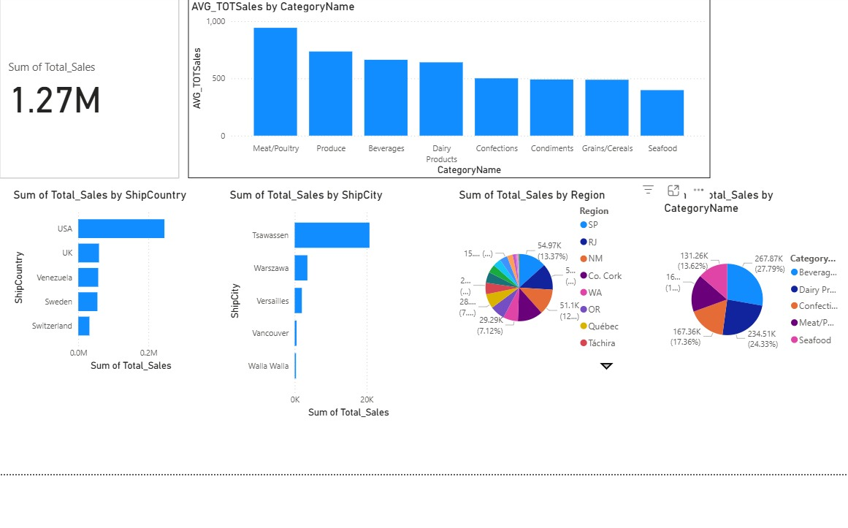
SALES DASHBOARD

Slide 7
EMPLOYEE PERFORMACE OF NORTHWIND TRADERS
1) Overall Sales Performance
The total sales amount recorded is approximately $1.05 million.
Top performer: Margaret with sales of $232,890.85, followed by Janet and Nancy.
Sales contributions are well distributed among the top employees, indicating a balanced team performance.
2) Employee Distribution by Title
The majority of employees are Sales Representatives, showing that the company’s sales operations rely heavily on front-line staff.
A smaller number of employees hold positions such as Inside Sales Coordinator, Sales Manager, and Vice President of Sales, reflecting a lean management structure.

Slide 8
3) Sales by Country
USA contributes 55.56% of total employee count, while the UK accounts for 44.44%.
This suggests a strong market presence in both countries, with the USA slightly leading.
4)Employee Hire Trends
Employee hiring peaked between 1992 and 1994, indicating long-standing staff retention and experience in the team.
Stable hiring patterns suggest consistent growth and a mature sales department.
Employee Summary
The dashboard shows a total of 9 employees analyzed in this dataset.
Employee data includes key performance metrics such as First Name, Total Sales, Hire Date, Title, and Country.

Slide 9
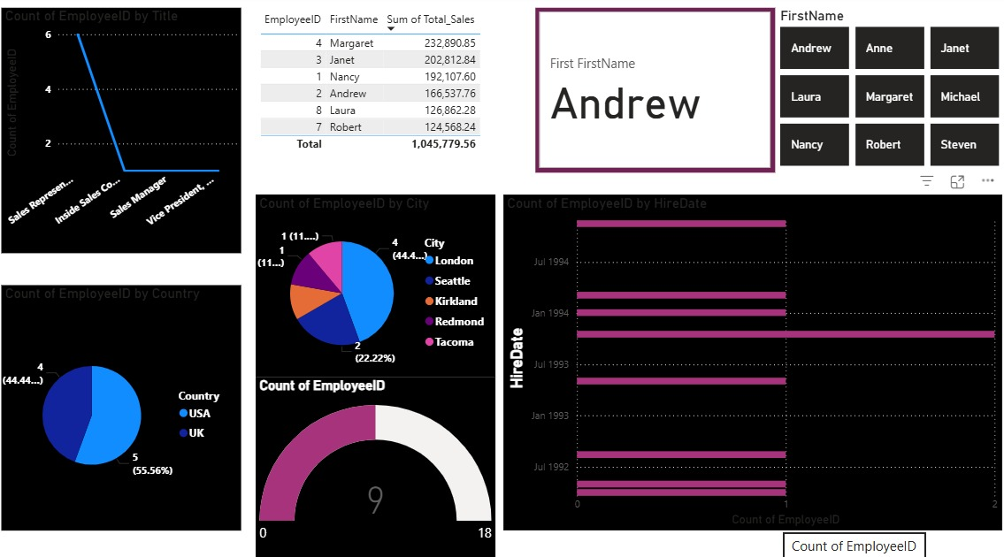
Employee Dashboard

Slide 10
Customer Behaviour
1. Customer Order Patterns
The highest number of orders were placed by a few key customers, indicating strong loyalty among top clients.
Customer IDs such as SAVEA, ERNST, and FOLKO recorded more than 25 orders each, showing consistent purchasing behavior.
The remaining customers placed between 10–20 orders, suggesting moderate engagement levels.
2) New vs. Repeat Customers
Repeat Customers: 822 (≈ 90.23%)
New Customers: 89 (≈ 9.77%)
This indicates a high customer retention rate, showing strong brand loyalty and satisfaction.
The data suggests that maintaining existing customers is a major strength, while new customer acquisition remains an area for improvement.

Slide 11
3) Sales by Customer
The top 3 customers — QUICK ($110.28K), ERNSH ($104.87K), and SAVEA ($104.36K) — contribute a significant share of total revenue.
Together, these three customers account for nearly one-fourth (≈24.8%) of the total sales.
This concentration indicates dependence on a few high-value customers, making customer relationship management crucial.
4) Customer Distribution by Country
Germany and the USA are the top markets, each contributing 14.7% of total customers.
Brazil (10%), UK (9.28%), France (6.75%), and Venezuela (4.82%) follow closely behind.
This reflects a strong international presence, with key customer bases in both North America and Europe.
There is an opportunity to expand customer engagement in smaller markets like Austria, Sweden, and Venezuela.

Slide 12
5) Key Customer Behavior Insights
Most customers are repeat buyers, proving high satisfaction and brand trust.
A few key customers drive a large portion of sales, showing high-value relationships.
Top countries (Germany, USA, Brazil, and UK) dominate the customer base — strong opportunities exist for targeted marketing campaigns here.
Product performance data suggests that a few premium items are leading revenue growth, highlighting potential for cross-selling or bundling strategies

